Slide 1
[CDB22CSDJF001]-[Pension Management System]
Team Member Names
1. Narayan Mishra
2. Rituraj Harsh
3. Shikhar Gupta
4. Ranjeet Kumar Rout
5. Aditya Raj Sharma
6. Dinesh B

Slide 2
Table of Contents
Introduction
Technologies Used
Application Architecture
Microservices
Wireframe
Junit Testing
Demo

Slide 3
Introduction
A pension management system is an online system that allows state government to automate a portion of the Pension detail provisioning.
This pension management system can do pensioner detail provision, calculate provision, initiate pension disbursement.
This whole process saves a lot of time for the pensioner as well as state government.

Slide 4
Technologies Used
Hardware : Developer Desktop PC / Laptop with 8GB RAM
Software :
Eclipse
Have PMD Plugin
Configure Maven in Eclipse
Apache Maven 3.8.7
Postman v9.4 Client
Visual Studio 2022 version 17.2
ReactJs and NodeJs
H2 Database

Slide 5
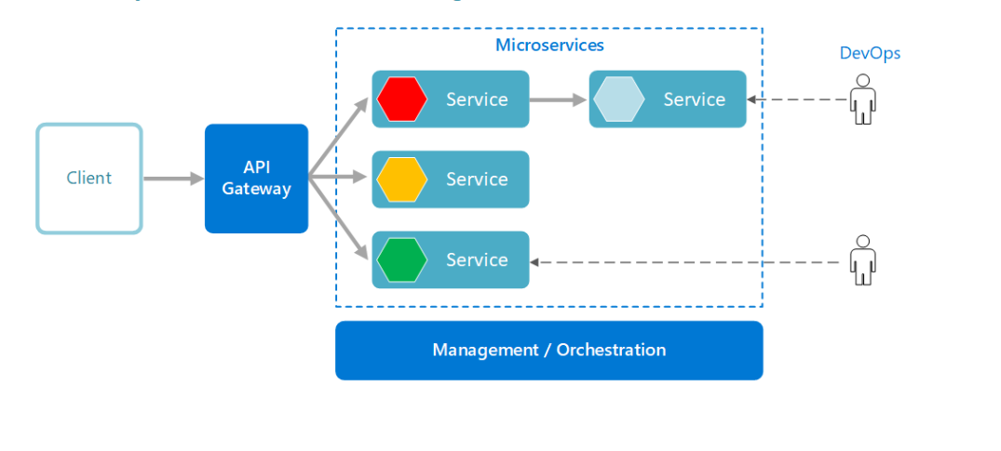
Application Architecture

Slide 6
Authorization Microservices
Authorization Microservices is a Microservice that Generates JWT token as well as validate that token.
Endpoints of Authorization Microservice:
1. authenticate
2. authorize

Slide 7
Pensioner Detail Microservices
Pensioner Detail Microservice is a Microservice that deals with the information like aadhaar number, name, pan number, last salary, bank account number, bank name, etc.
Endpoints of Pensioner Detail Microservice:
1. pensionerdetailbyaadhaar

Slide 8
Process Pension Microservices
Process Pension Microservice is a Microservice that performs the operations processing the pension, validating the pensioner by his/her aadhaar number, calculating pension amount as well.
Endpoints of Process Pension Microservice:
1. pensiondetail
2. processpension

Slide 9
Pension Disbursement Microservices
Pension Disbursement Microservice is a Microservice that communicates with Process Pension and Pension Detail microservices to perform operations like validating the pension amount whether it is right or wrong and returns the response code 10 or 21.
Endpoints of Pension Disbursement Microservice:
1. disbursepension

Slide 10
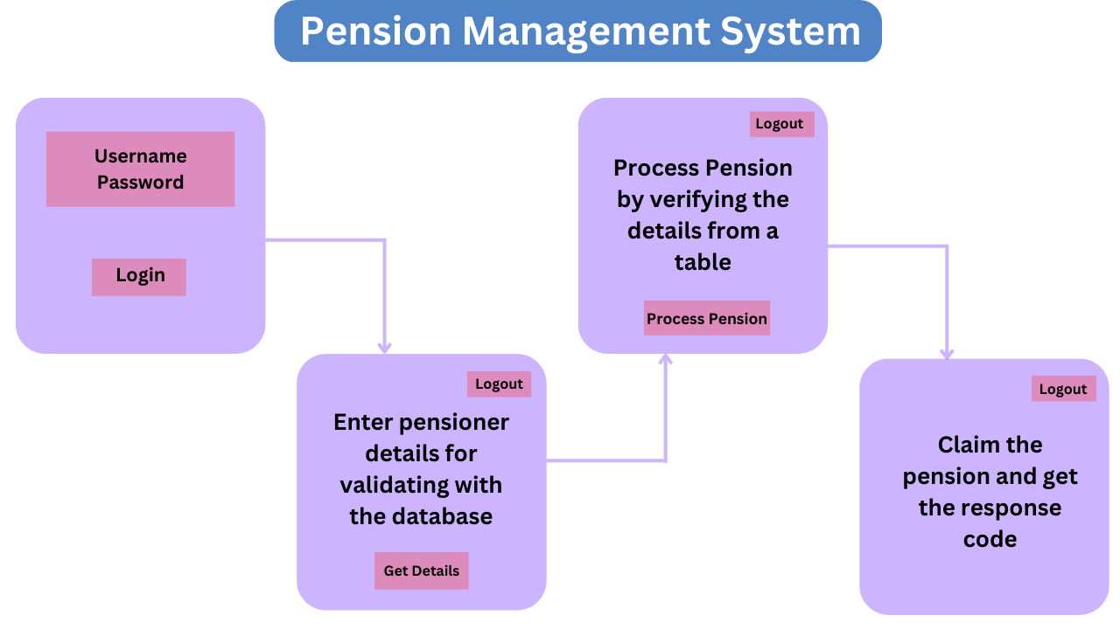
WireFrame Diagram

Slide 11
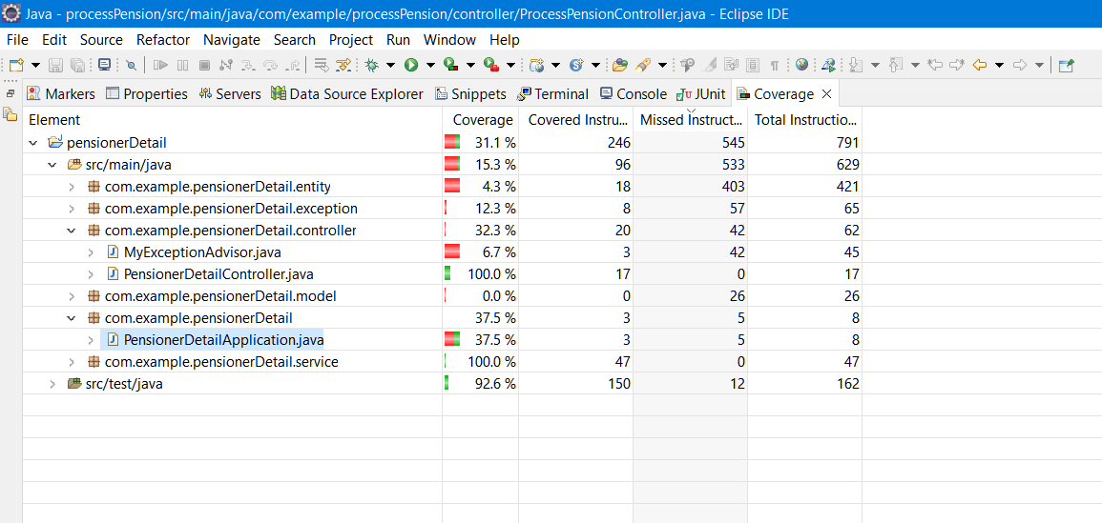
Junit Testing for Pensioner Detail Microservices

Slide 12
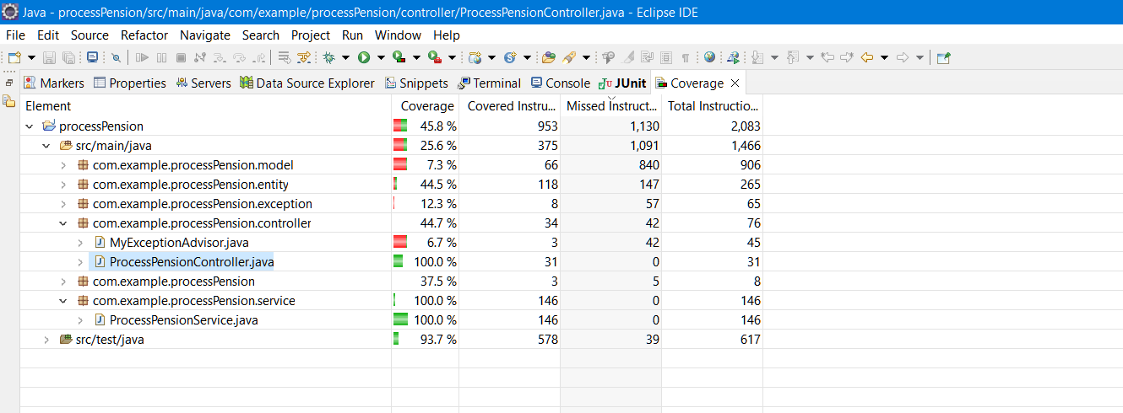
Junit Testing for Process Pension Microservices

Slide 13
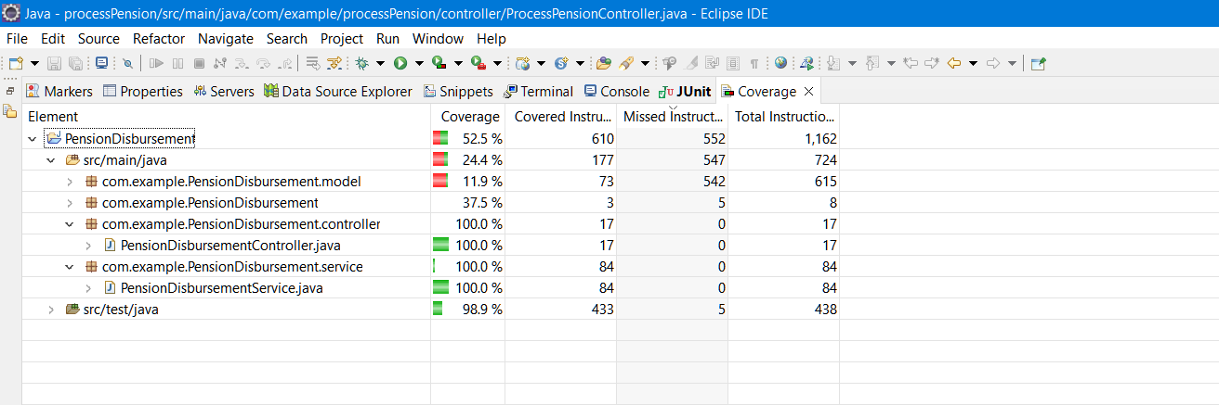
Junit Testing for Pension Disbursement Microservices

Slide 14
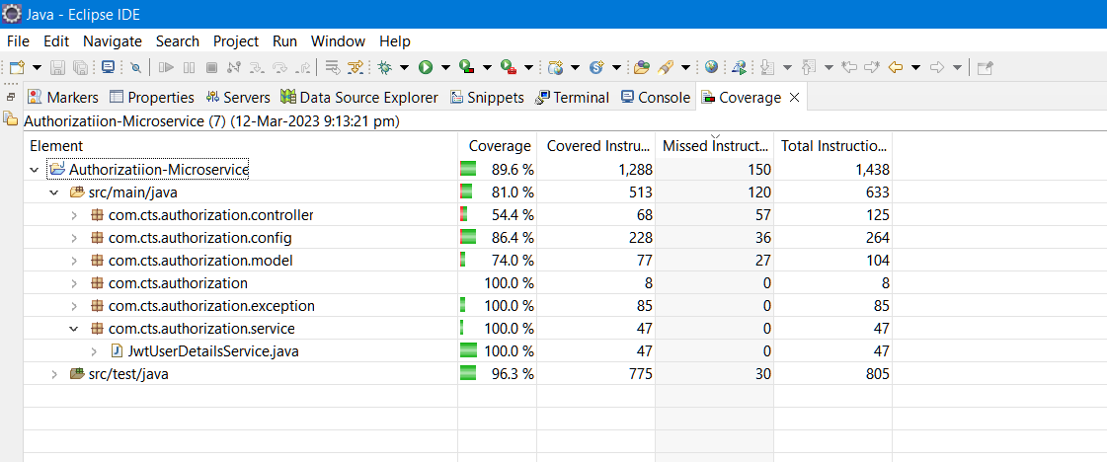
Junit Testing for Authorization Microservices

Slide 15
Let us take you through the Demo.

Slide 16
Thank You!
Team Member Names
1. Narayan Mishra
2. Rituraj Harsh
3. Shikhar Gupta
4. Ranjeet Kumar Rout
5. Aditya Raj Sharma
6. Dinesh B

